Slide 1
Feature extraction for audio
Intermediate seminar presentation (AML-R)
Marcus Cramer

Slide 2
Agenda
Basic concepts of (digital) sound
Fast Fourier Transform
Features and application examples

Slide 3
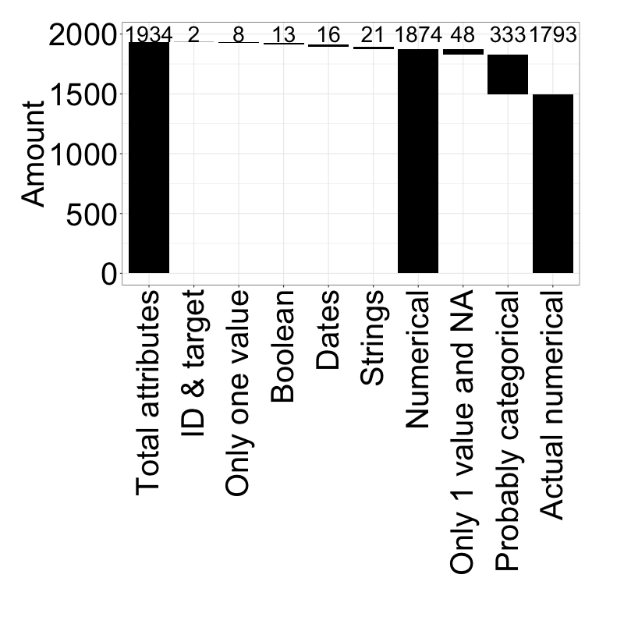
Different attribute types must be handled seperately
Number of attributes per attribute type
Derivation described in the following

Slide 4
Beautify
Different NA encodings
Obvious NAs: -1 (all other values positive), [], blank
More sophisticated:
Find columns with negative mean of unique values and remove outliers -> results in positive mean of unique values -> outlier = -99999 -> NA encoding
Take mean of unique values and mean of unique values minus one extremum on both sides -> if first value is more than 10 times higher than second value, we probably have an illogically high maximum value -> this is the case for 1+e09, 9999, 99, 100
Sometimes, the second highest value also seems to be some sort of NA encoding (same approach as above but removed second maximum too) -> 9996, 9998, 98
For other columns, a couple of extreme outliers exist. The maximum of extreme outliers is 5 values, which are more than 10000 times higher than the rest in the same column -> 999999999, 999999998, 999999997, 999999996, 999999995, 999999994
Everything double checked for plausibility with random manual samples
Made sure that data is unlikely to be factors (then these encodings might stand for sensible values)

Slide 5
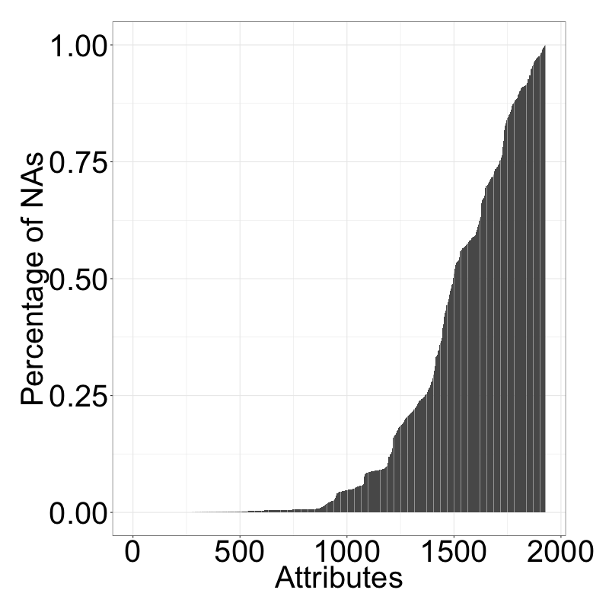
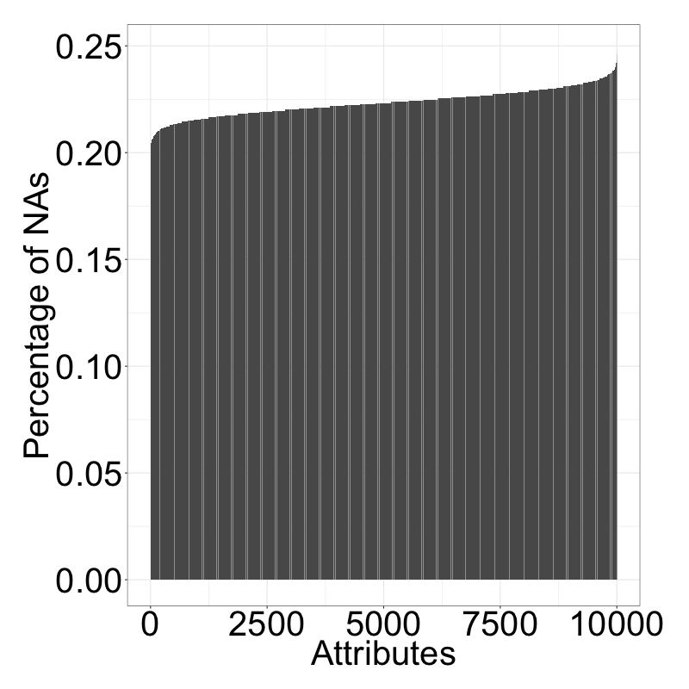
Nas in samples fairly constant While varying a lot for attributes
NA values per attribute in %
NA values per sample in %

Slide 6
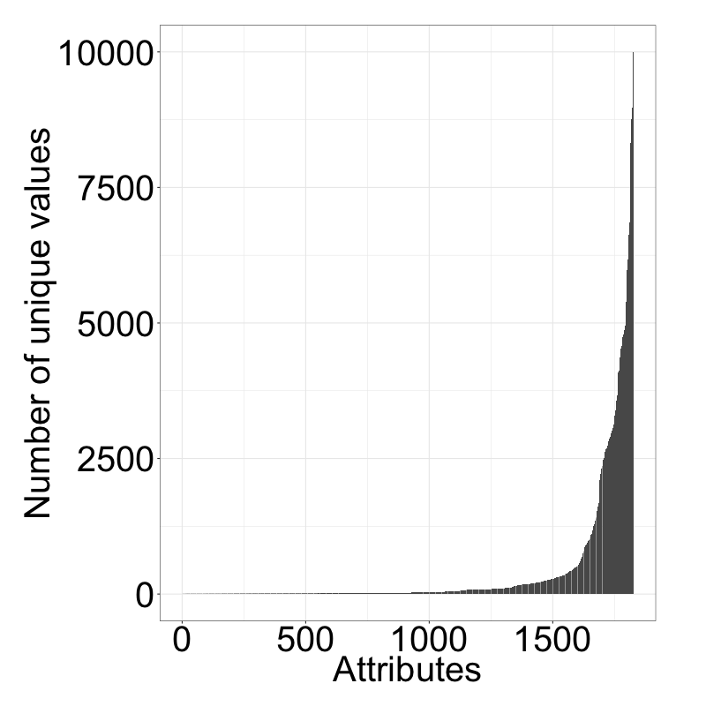
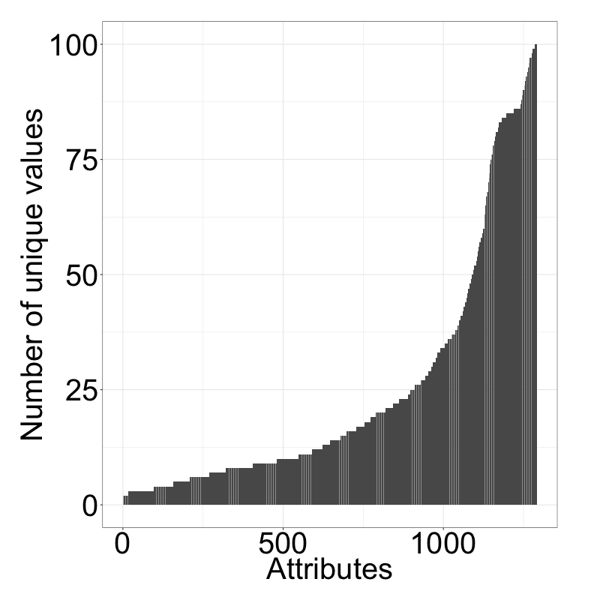
Numerical/categ. values hard to differentiate via “elbow-criterion”
Number of unique values per attribute
Number of unique values (<101)

Slide 7
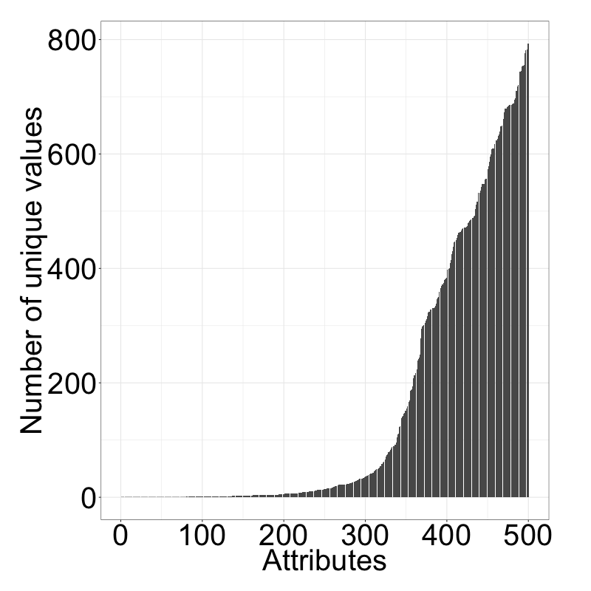
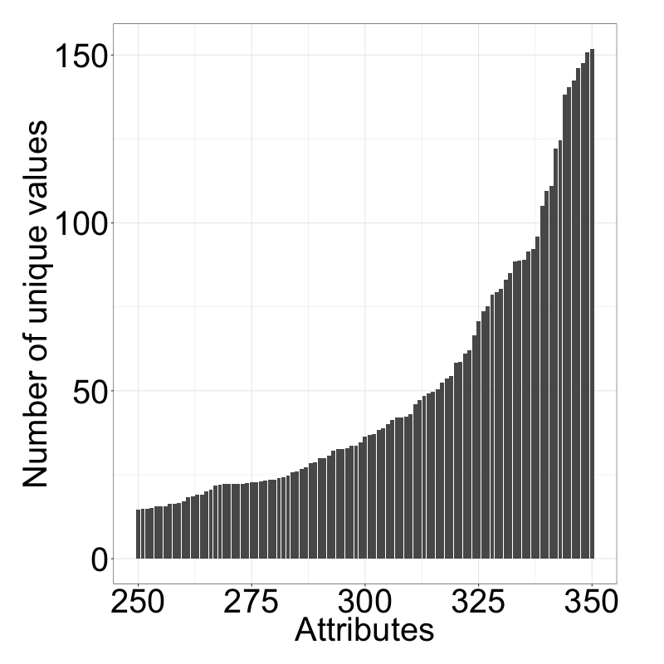

Elbow criterion applied to variances of unique values more insightful
Var. between unique values (lowest 500)
Var. between unique values (250-350)
Elbows
Elbow
Highest difference between the 343. and the 344. attribute. We therefore assume, that the attributes 1-343 (sorted by variance) are candidates for categorical attributes.

Slide 8
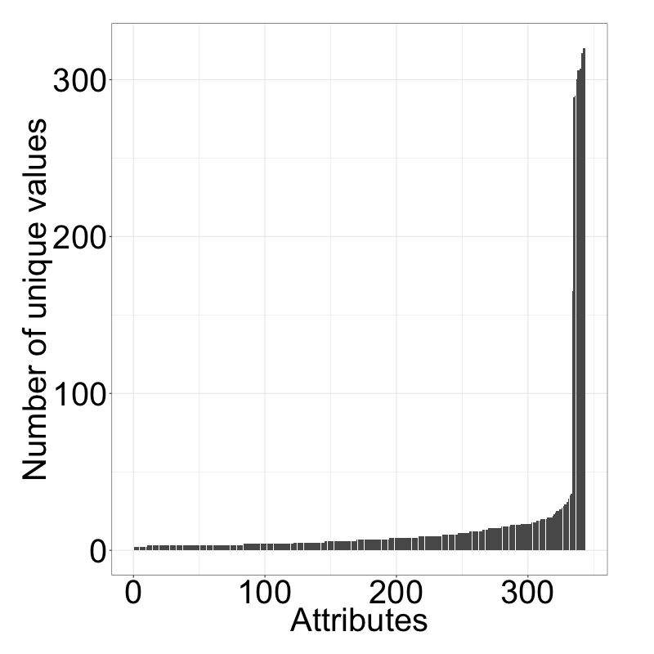
Reapplying this to the number of unique values reveals drastic elbow
Number of unique values per attribute
Highest gap between 333 and 334, it seems reasonable that out of the 343 attributes with the lowest variances, the attributes with the lowest number of unique values are categorical
Elbow
We identified 333 attributes, that are likely to be categorical. This is just a rough estimate, however, as the meaning of attributes is unknown.

Slide 9
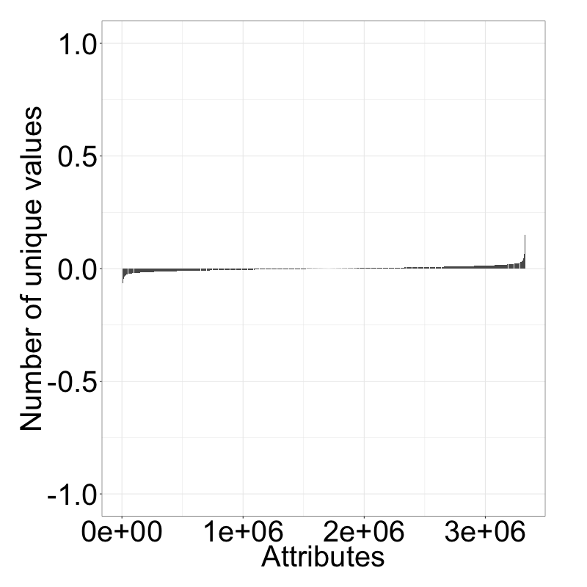
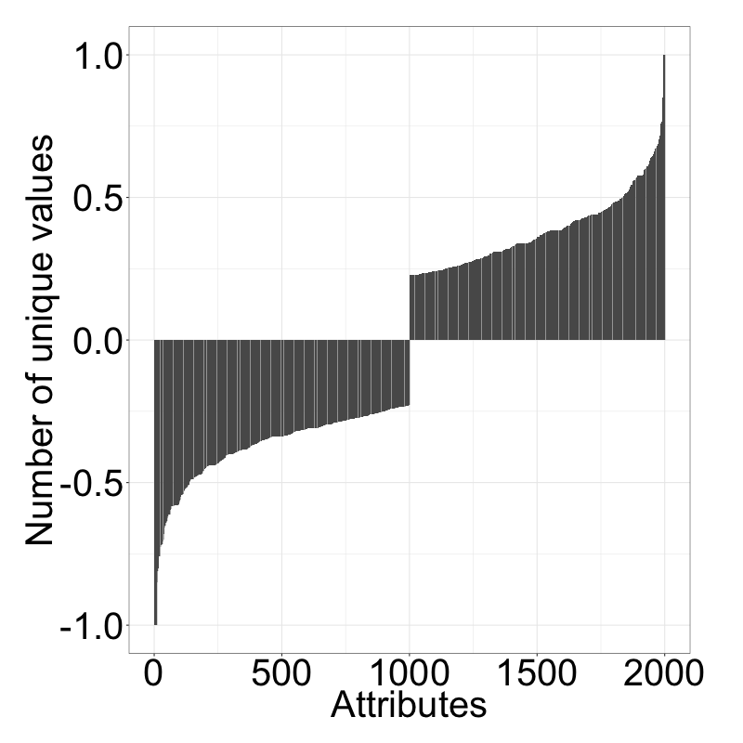
Attributes are highly uncorrelated
Correlations between all attributes
1000 lowest and highest correlations

Slide 10
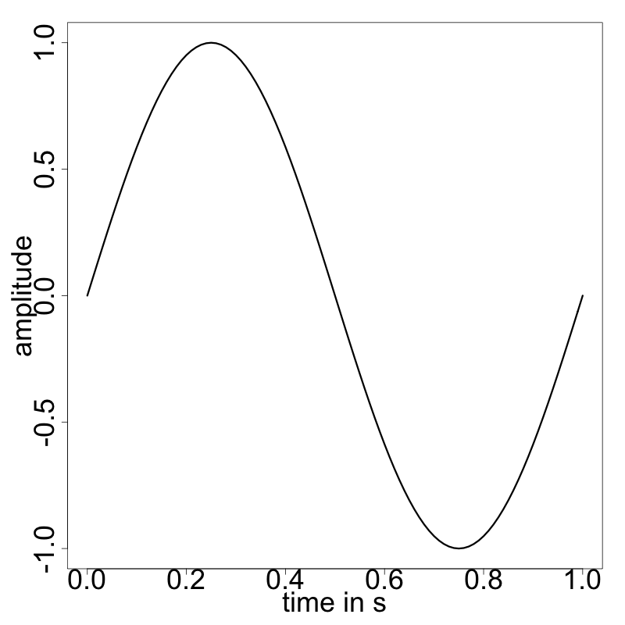
A very simple sound wave
Wave length
Perceived loudness of a sound
Rarefaction
Energy invested into moving the object
Compression
Perceived highness (treble) of sound
Frequency of the sound
Source: http://cmc.music.columbia.edu/musicandcomputers/

Slide 11
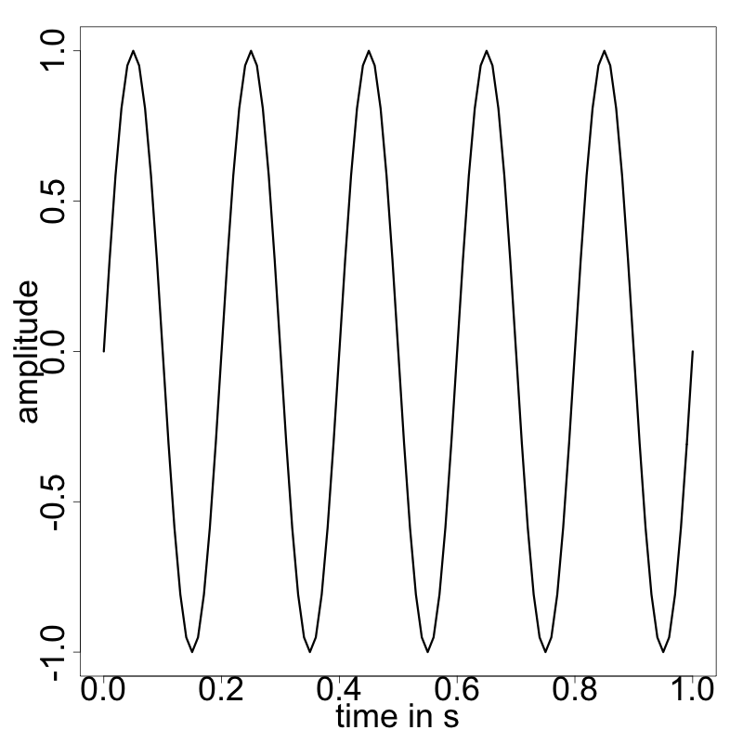
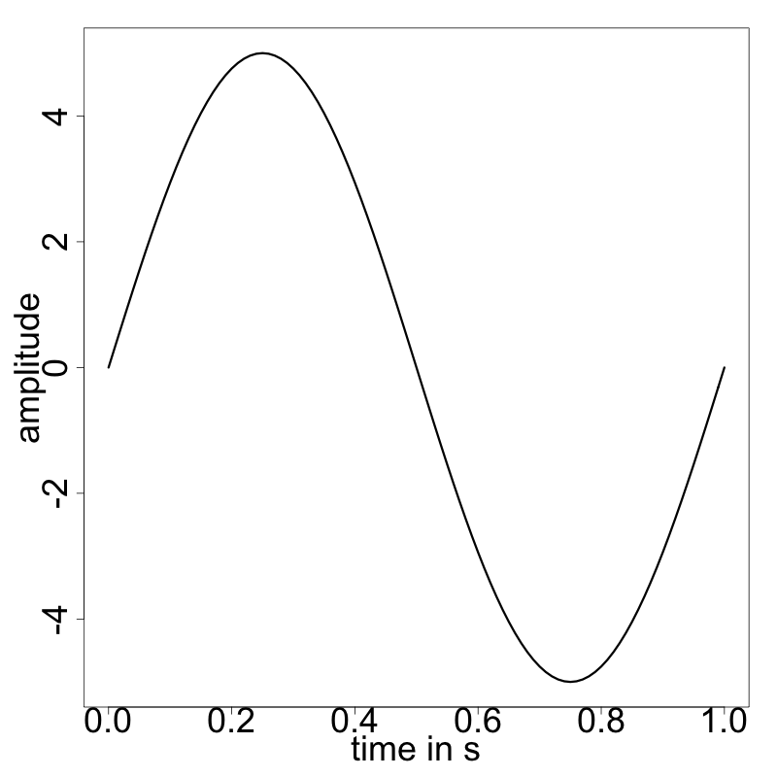
Alternations of the simple sound wave
Higher frequency, same amplitude
Same frequency, higher amplitude
Source: http://cmc.music.columbia.edu/musicandcomputers/

Slide 12

Digital representation of sound waves
The concept of samples
Sound waves are continuous, digital representation must be discrete
Samples represent the amplitude of a sound at a certain point in time
E.g. amplitude of 1 after 0.05s
E.g. amplitude of -1 after 0.35s
More samples means more hard drive storage space, so how many samples per second do we actually need?
Source: http://cmc.music.columbia.edu/musicandcomputers/

Slide 13
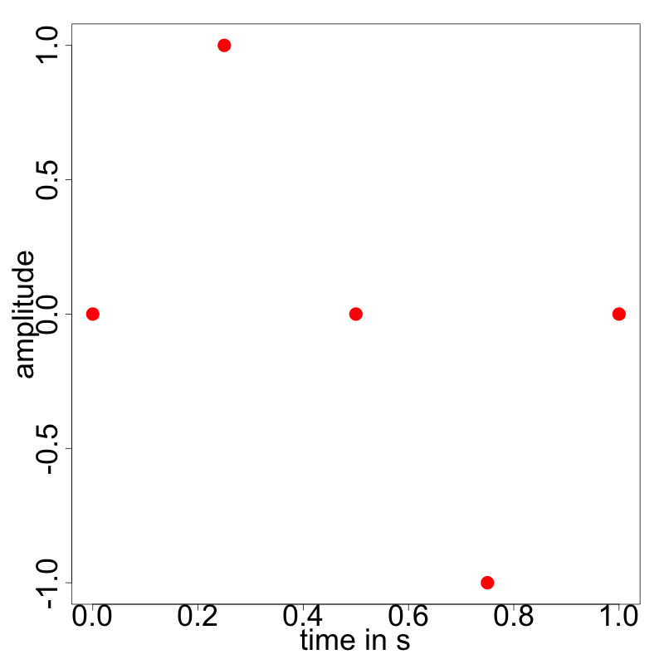
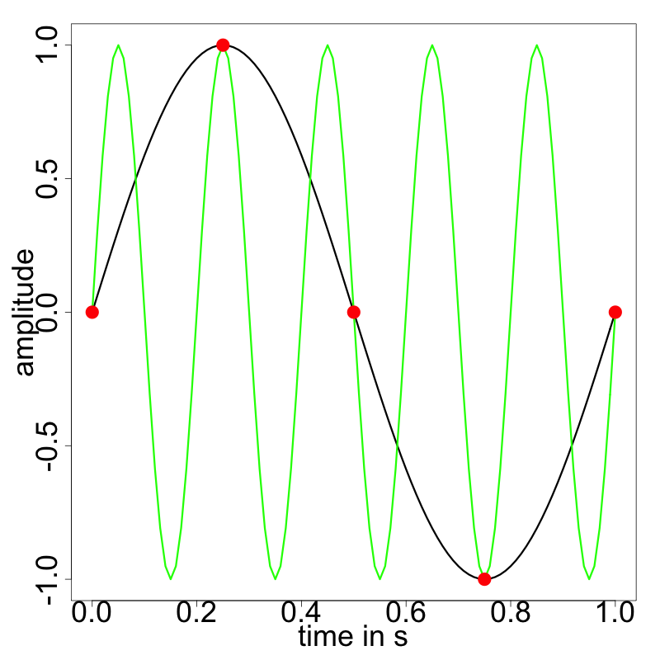
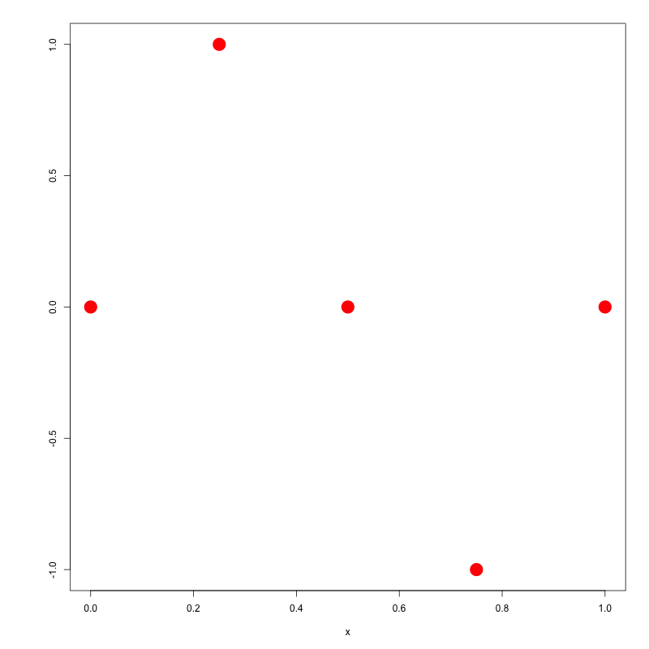
The problem of having to few samples
Undersampling
?
For accurate representation, at least 2*maximum frequency must be sampled (Nyquist theorem). Therefore, 44.1kHz is a common sample frequency (CD quality).
Source: http://cmc.music.columbia.edu/musicandcomputers/

Slide 14
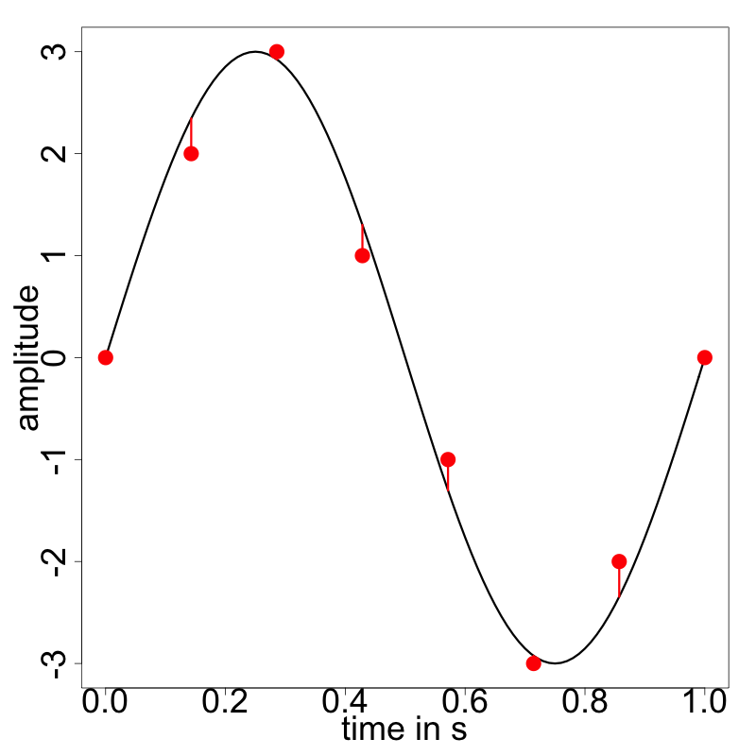
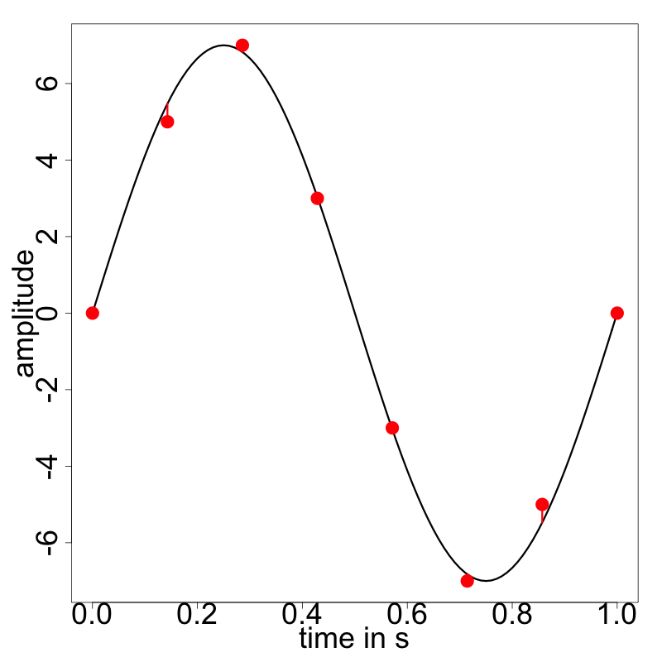
Storing the samples in different bit widths
Samples stored in 3 bits
Samples stored in 4 bits
Normalized MSE of 0.043
Normalized MSE of 0.017
The less bits are used, the less accurate the amplitude is represented (tradeoff for saving of storage space). Common bit widths are 8, 16, 24, 32 bits.
Source: http://cmc.music.columbia.edu/musicandcomputers/

Slide 15
The mathematics behind soundwaves are based on Trigonometry
Phasor
The phasor spins at a frequency of 1Hz (1 turn per second)
This results in a sinusoid of frequency 1
The sinusoid is drawn according to the location of the arrowhead and the time passed
Progress in time
Source: http://cmc.music.columbia.edu/musicandcomputers/

Slide 16
The mathematics behind soundwaves are based on Trigonometry
Phasor
The phasor spins at a frequency of 1Hz (1 turn per second)
This results in a sinusoid of frequency 1
The sinusoid is drawn according to the location of the arrowhead and the time passed
Progress in time
Source: http://cmc.music.columbia.edu/musicandcomputers/

Slide 17
The mathematics behind soundwaves are based on Trigonometry
Phasor
The phasor spins at a frequency of 1Hz (1 turn per second)
This results in a sinusoid of frequency 1
The sinusoid is drawn according to the location of the arrowhead and the time passed
Progress in time
Source: http://cmc.music.columbia.edu/musicandcomputers/

Slide 18
The mathematics behind soundwaves are based on Trigonometry
Phasor
The phasor spins at a frequency of 1Hz (1 turn per second)
This results in a sinusoid of frequency 1
The sinusoid is drawn according to the location of the arrowhead and the time passed
Progress in time
Source: http://cmc.music.columbia.edu/musicandcomputers/

Slide 19
The mathematics behind soundwaves are based on Trigonometry
Phasor
The phasor spins at a frequency of 1Hz (1 turn per second)
This results in a sinusoid of frequency 1
The sinusoid is drawn according to the location of the arrowhead and the time passed
Progress in time
Source: http://cmc.music.columbia.edu/musicandcomputers/

Slide 20
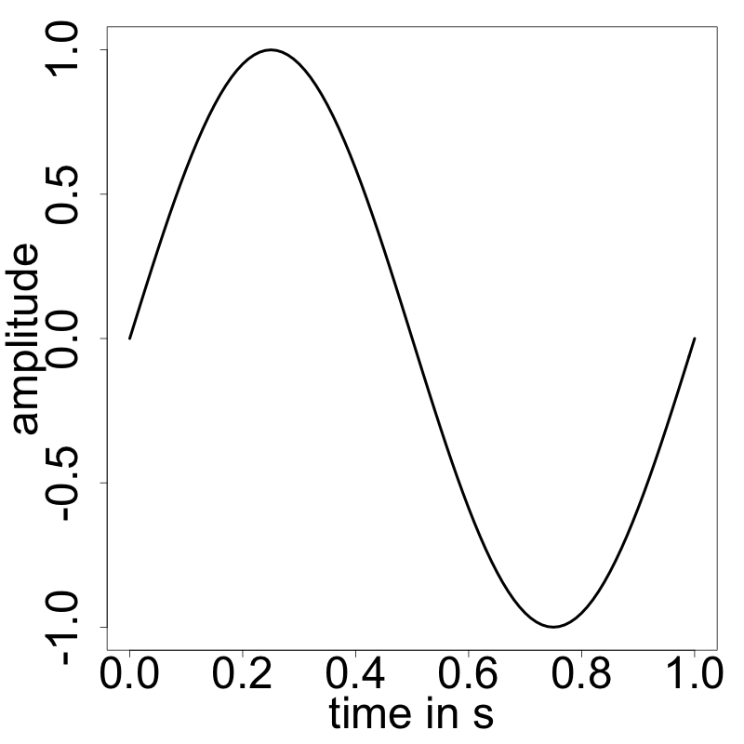
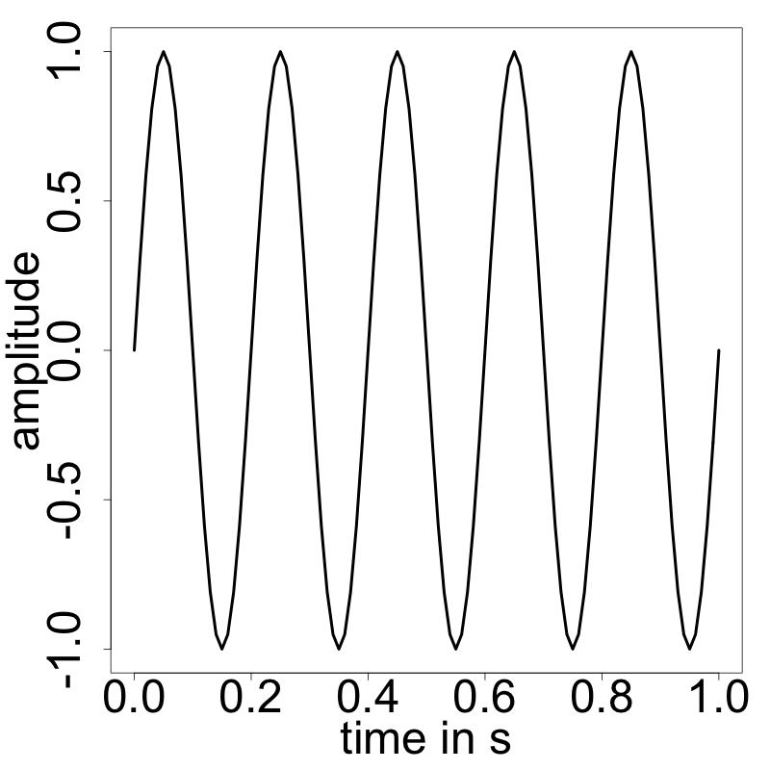
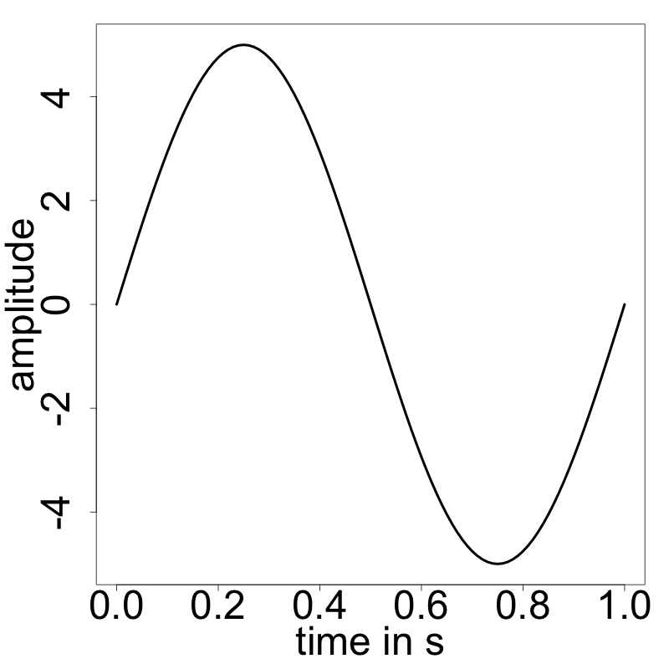
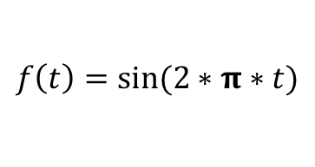
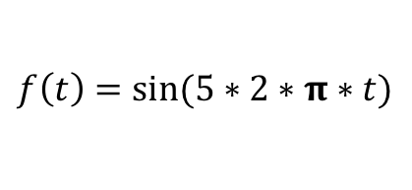
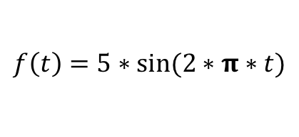
Sound waves can be easily manipulated based on sinus function
$$f\left(t\right)=sin⁡(2∗π∗t)$$
$$f\left(t\right)=sin⁡(5∗2∗π∗t)$$
$$f\left(t\right)=5∗sin⁡(2∗π∗t)$$

Slide 21
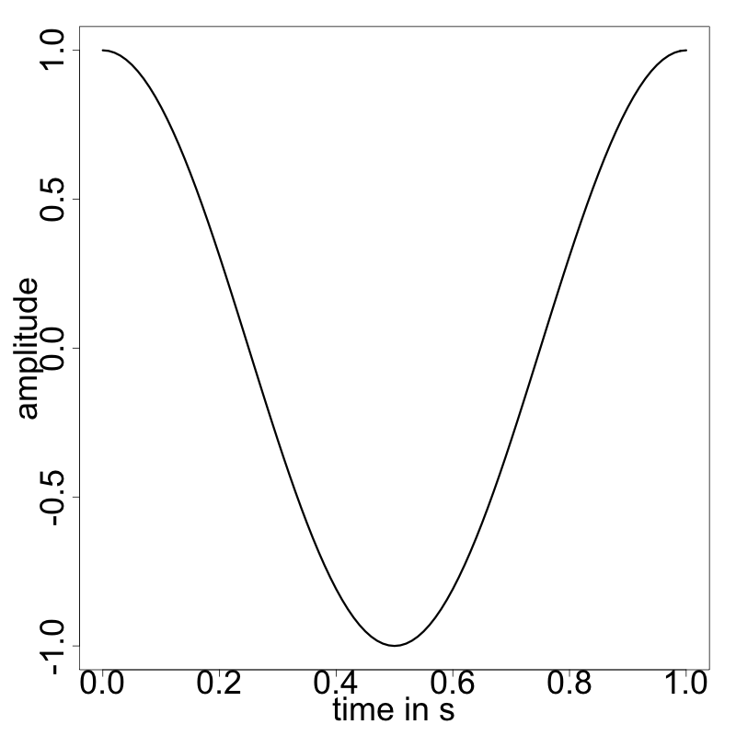
Sound waves can Also be phase-shifted
$$f\left(t\right)=sin(2∗π∗t+π/2)$$
$$f\left(t\right)=cos(2∗π∗t)$$

Slide 22
Agenda
Basic concepts of (digital) sound
Fast Fourier Transform
Features and application examples

Slide 23
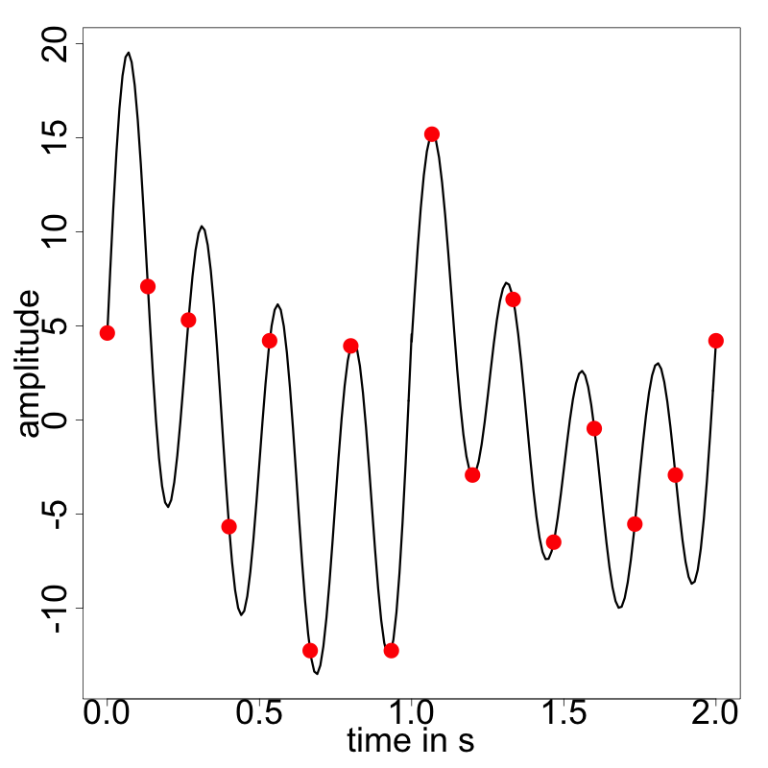
Stored samples do not directly yield useful features
More complex wave form
Samples stored in 8 bits¹
4.627451 | 4.215686
7.098039 | -12.254902
5.313725 | 3.941176
-5.666667 | -12.254902
… | …
1) Values on one of 256 points between -15 and +20
What do these values tell us about the characteristics of the sound?
Not much!
We need information on concrete frequencies.

Slide 24
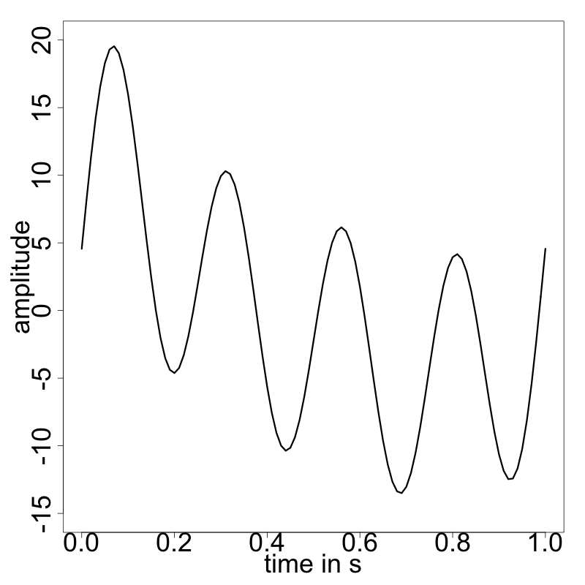
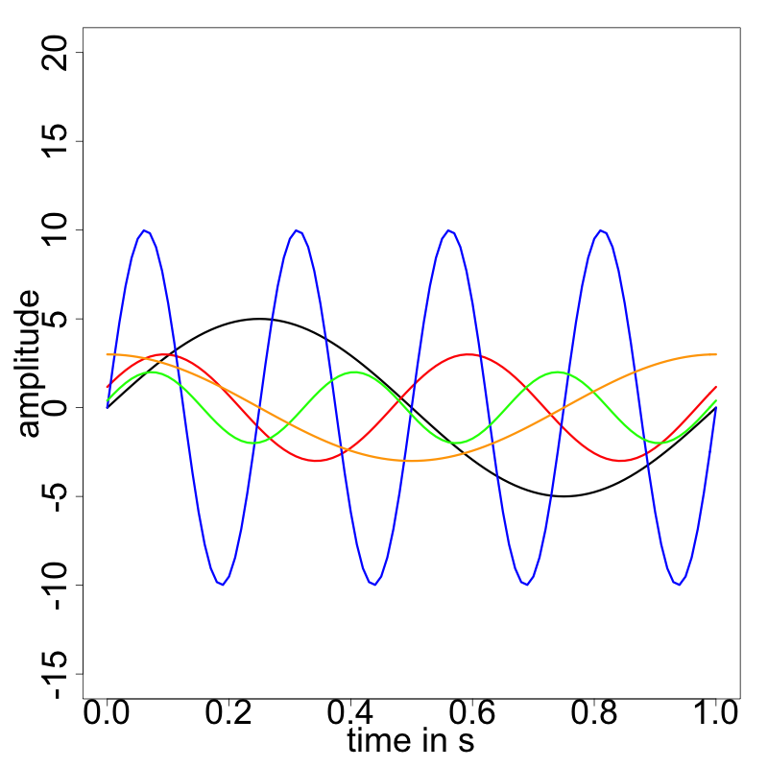
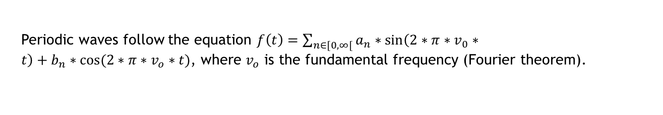
Sine and cosine curves can be combined to form every wave form
Complex wave form
Components of the wave form
Periodic waves follow the equation $f\left(t\right)=\sum_{n∈[0,∞[}{a_{n}∗\sin\left(2∗π∗v_{0}∗t\right)+b_{n}∗\cos{(2∗π∗v_{o}∗t)}}$, where $v_{o}$ is the fundamental frequency (Fourier theorem).
Source: cf. James (2011)

Slide 25
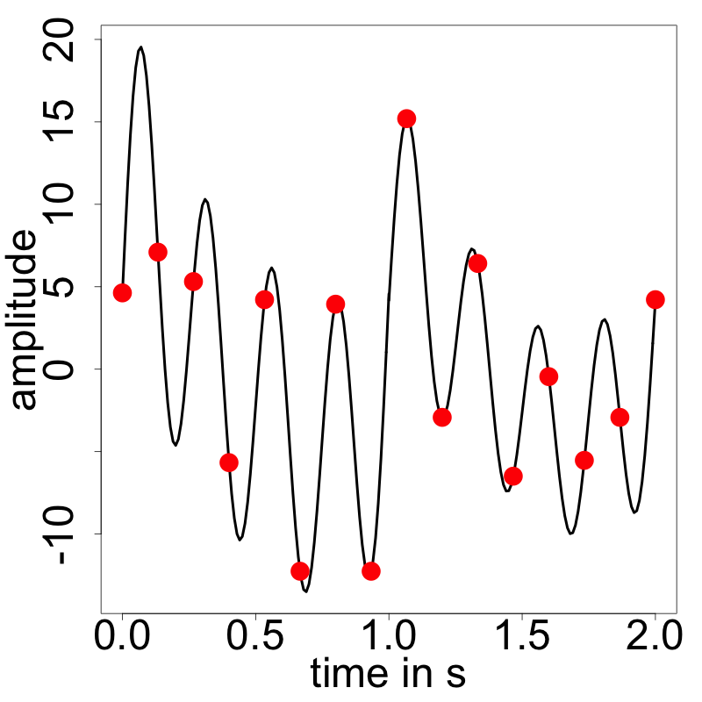

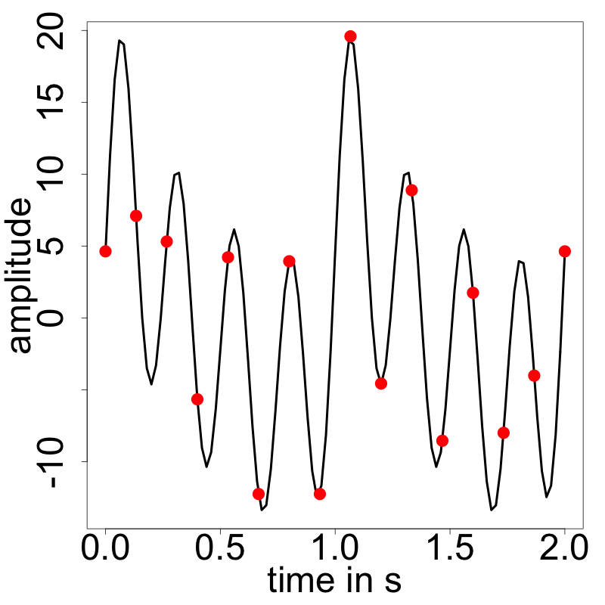
Fast fourier transform can be used to derive the frequencies
1
Take a certain chunk of samples and interpret as a continuous wave function
Source: http://cmc.music.columbia.edu/musicandcomputers/

Slide 26
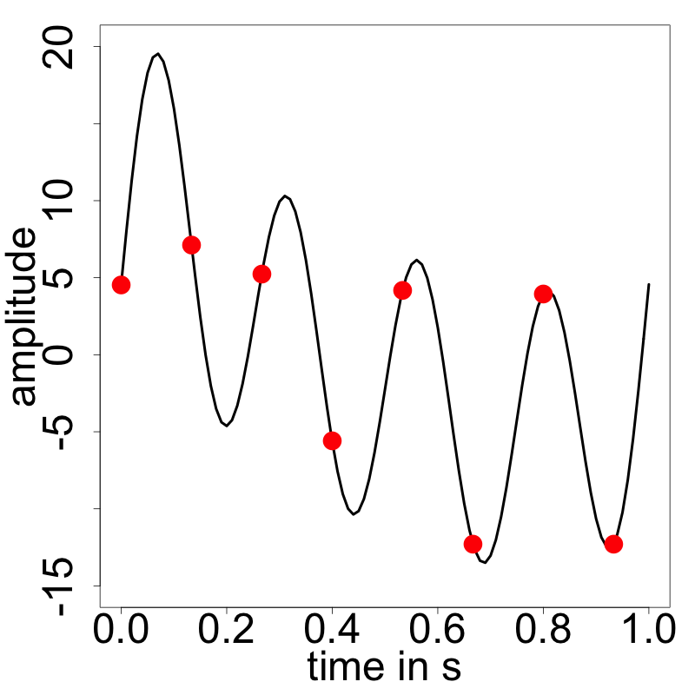
Fast fourier transform can be used to derive the frequencies
1
Take a certain chunk of samples and interpret as a continuous wave function
2
Decide on a frame size (so the number of samples used) and calculate frequency bands
Problem: If we pick 8 samples, we can classify the frequencies better; but we treat all samples as occurring in one point in time and lose time-dependent information
Source: http://cmc.music.columbia.edu/musicandcomputers/

Slide 27
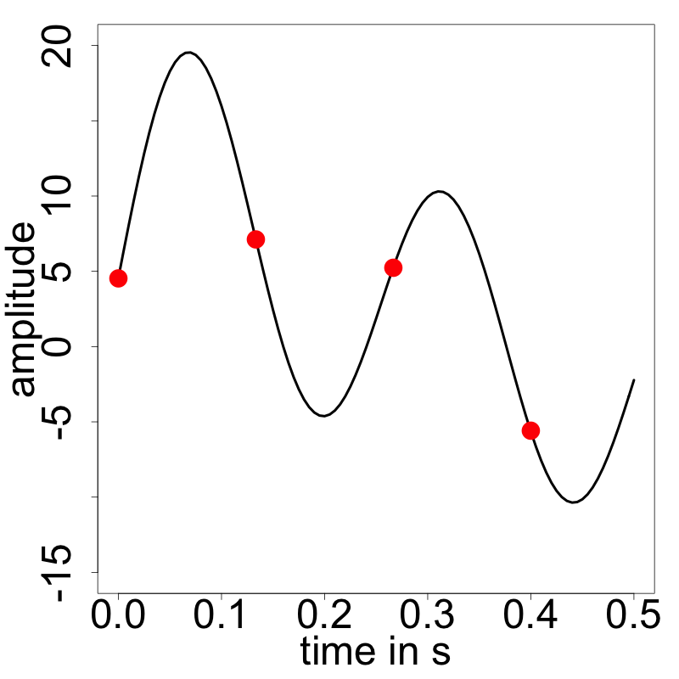
Fast fourier transform can be used to derive the frequencies
1
Take a certain chunk of samples and interpret as a continuous wave function
2
Decide on a frame size (so the number of samples used) and calculate frequency bands
Problem: If we pick 4 samples, we can differentiate between what happens in the first half and the second half of the second; but distinguishing frequencies becomes harder
Source: http://cmc.music.columbia.edu/musicandcomputers/

Slide 28
Fast fourier transform can be used to derive the frequencies
1
Take a certain chunk of samples and interpret as a continuous wave function
2
Decide on a frame size (so the number of samples used) and calculate frequency bands
3
Calculate the frequencies for every frequency band
Source: http://cmc.music.columbia.edu/musicandcomputers/

Slide 29
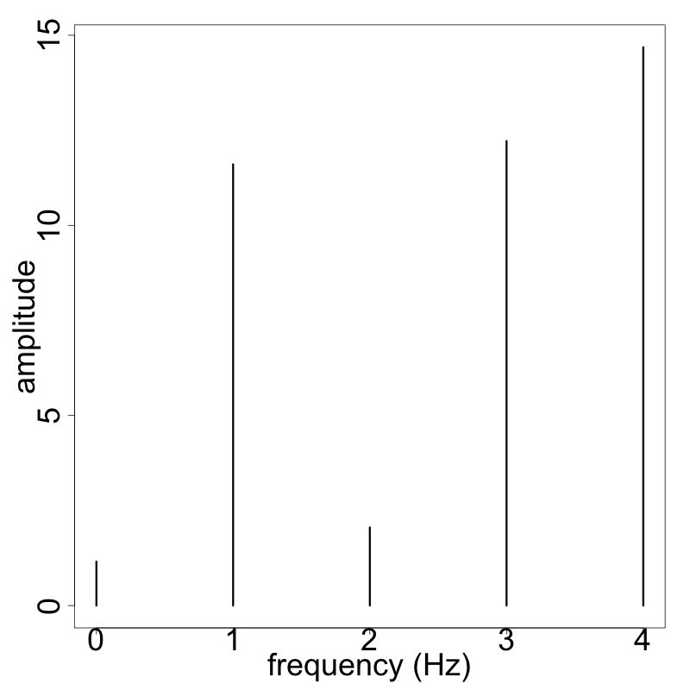
Calculation of frequency bands (8 samples)
Original sound wave
Results of FFT
Why so high?
DC offset
Source: Inspired by http://www.abstractnew.com/2014/04/the-fast-fourier-transform-fft-without.html and http://www.di.fc.ul.pt/~jpn/r/fourier/fourier.html

Slide 30
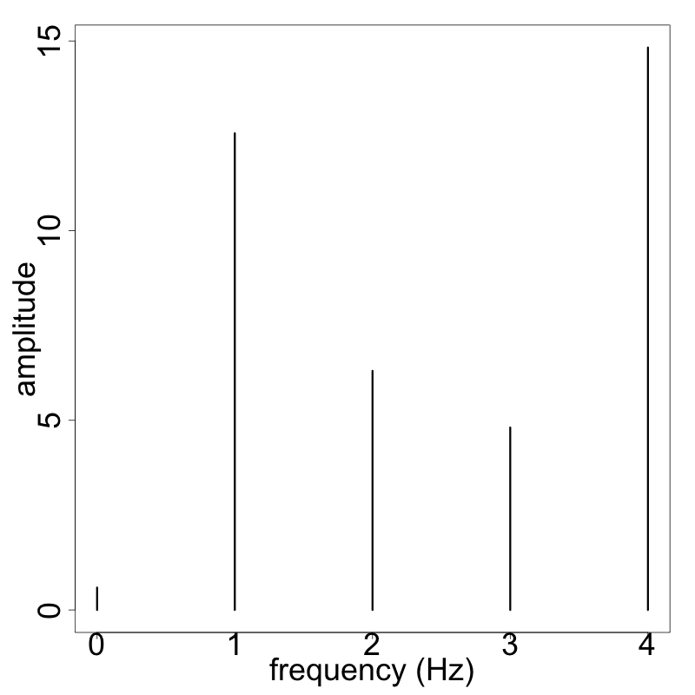
Calculation of frequency bands (16 samples)
Original sound wave
Results of FFT
Much better
Source: Inspired by http://www.abstractnew.com/2014/04/the-fast-fourier-transform-fft-without.html and http://www.di.fc.ul.pt/~jpn/r/fourier/fourier.html

Slide 31
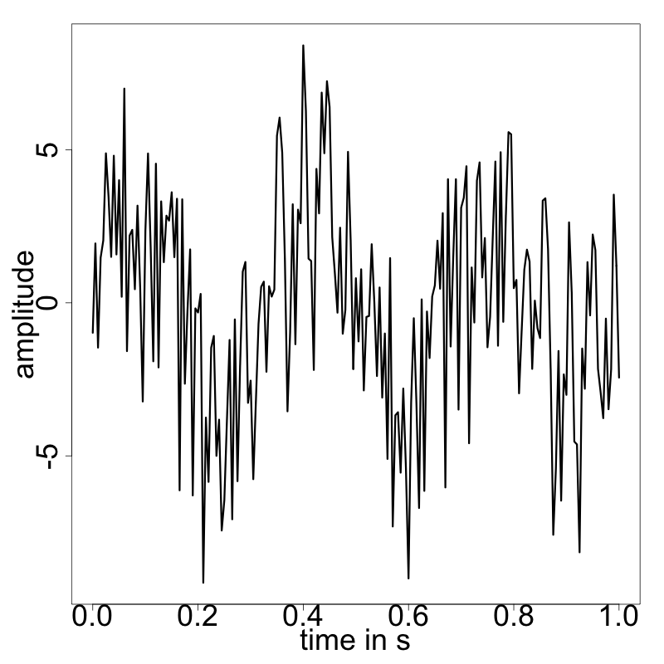
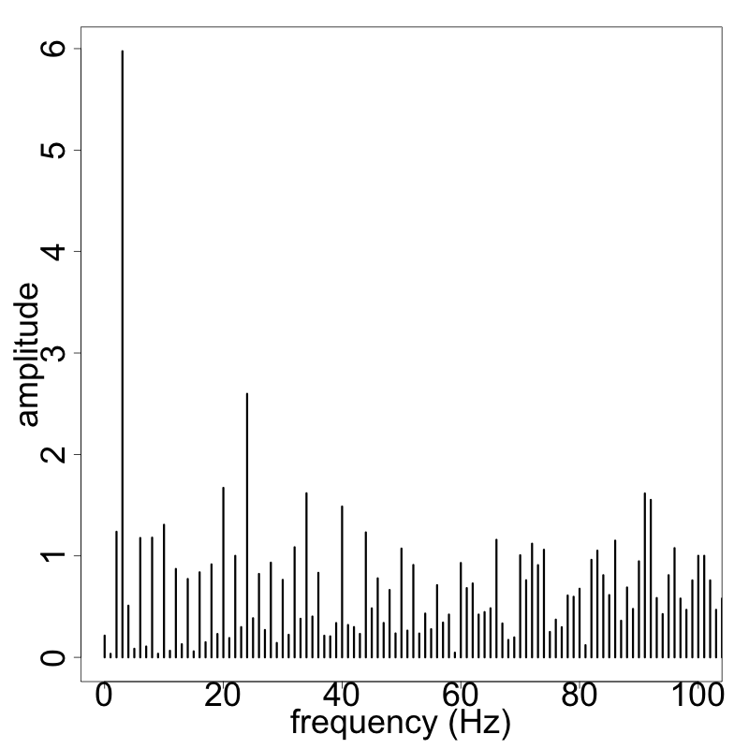
Audio processing always involves noise
Sound wave with heavy noise
Results of FFT
FFT analysis reveals a hidden harmonic at 3Hz. This can be used to e.g. identify the source of the sound.
Source: http://www.di.fc.ul.pt/~jpn/r/fourier/fourier.html

Slide 32
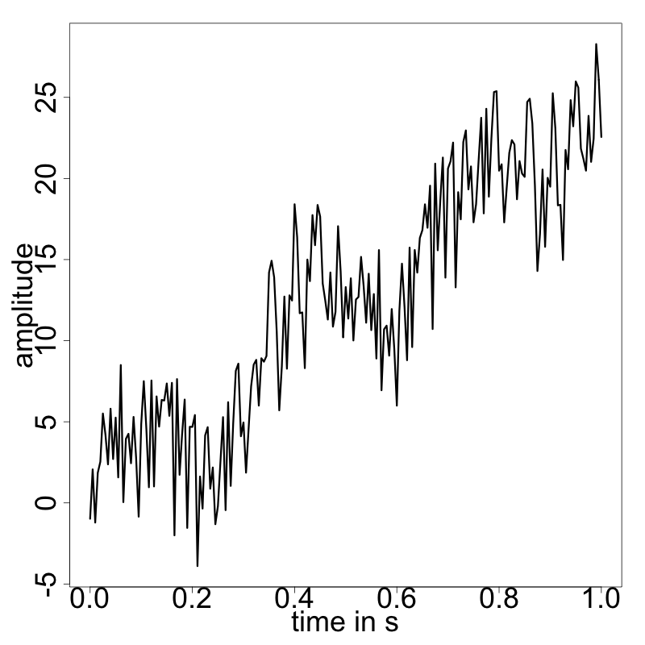
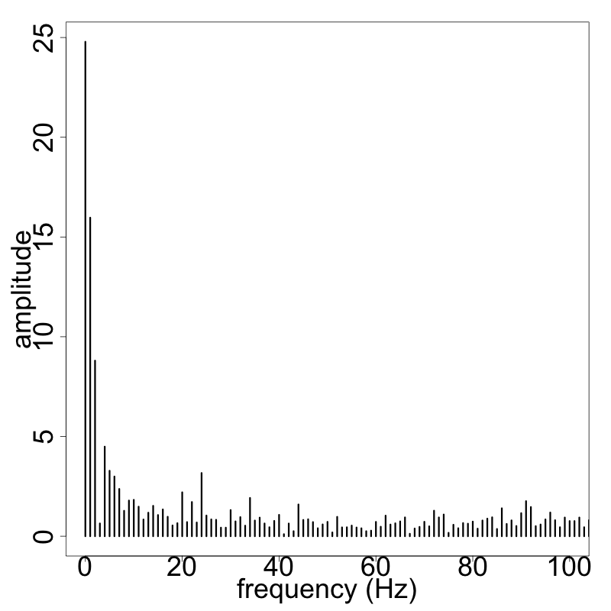
Trends from audio signals should be removed
Same sound wave with a trend
Results of FFT
Trends exaggerate the role of the DC offsets in spectral analysis.
Source: http://www.di.fc.ul.pt/~jpn/r/fourier/fourier.html

Slide 33
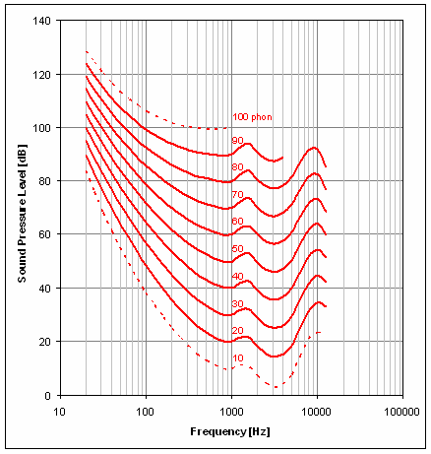
Major drawback: Human hearing is non-linear
FFT divides the frequency into bins of equal length
Problems:
Humans perceive certain frequencies louder than others
Perceived “highness” of a tone follows a logarithmic scale
E.g. musical tones
A0 = 27.5hz
A1 = 55hz
A2 = 110hz
sound pressure level (dB)
Alternative approaches like Wavelets handle this problem more efficiently
frequency (hz)
Source: e.g. Robinson, Dadson (1956), picture from http://www.diracdelta.co.uk/

Slide 34
Agenda
Basic concepts of (digital) sound
Fast Fourier Transform
Features and application examples

Slide 35

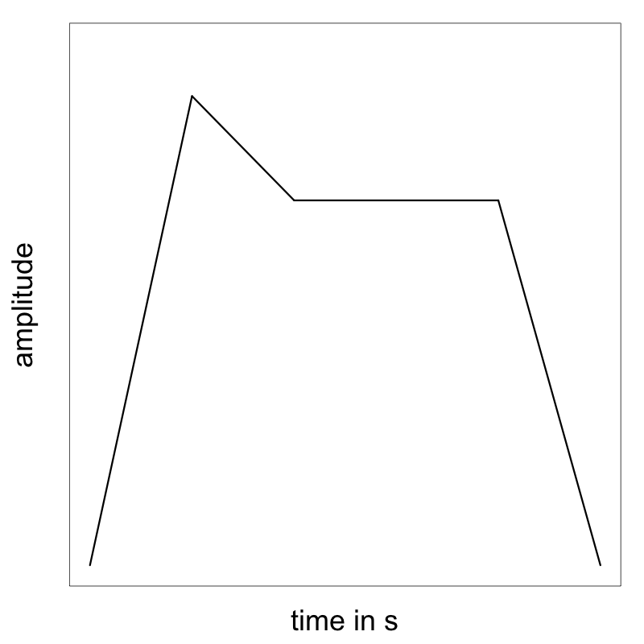
Exemplary sound features
Example: Attack time
Temporal features
Decay
Sustain
Attack
Release
Source: Peeters (2004)

Slide 36

Exemplary sound features
Example: Noise/harmonic part
Temporal features
Energy features
Noise
Source: Peeters (2004)

Slide 37
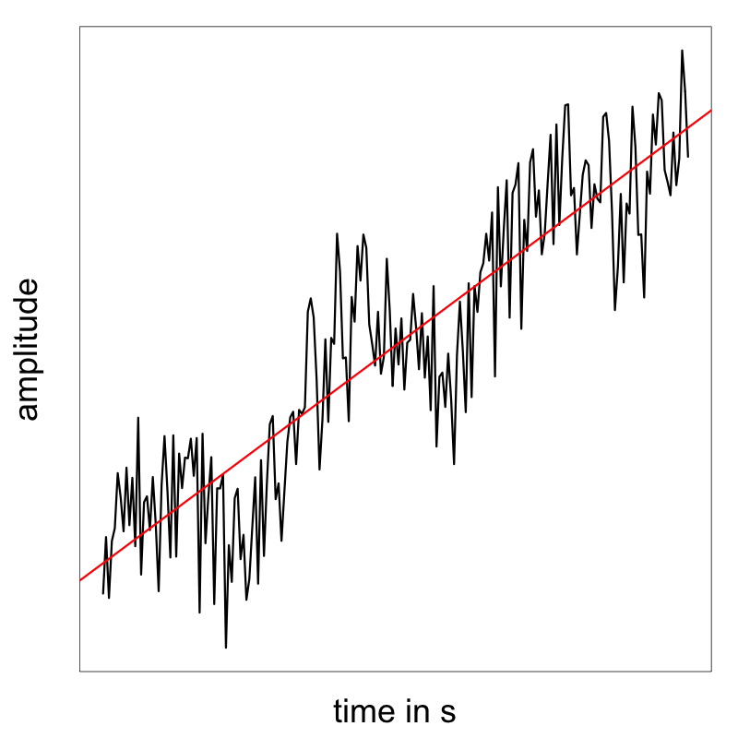

Exemplary sound features
Example: Spectral slope
Temporal features
Energy features
Spectral features
Source: Peeters (2004)

Slide 38
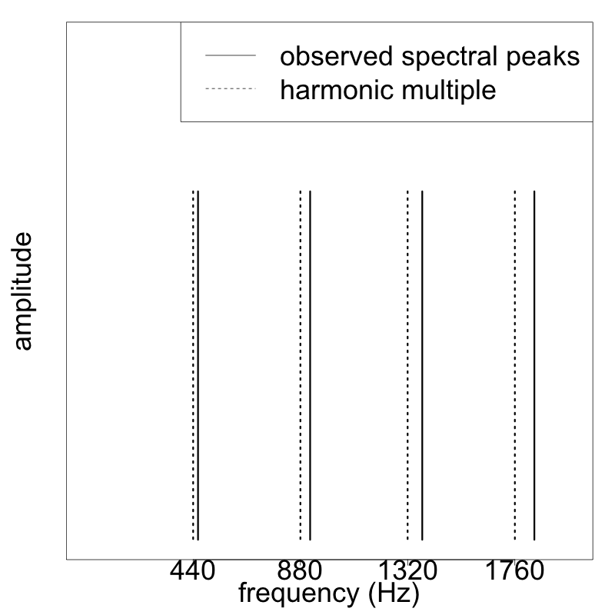

Exemplary sound features
Example: Inharmonicity
Temporal features
Energy features
Spectral features
Harmonic features
Source: Peeters (2004)

Slide 39
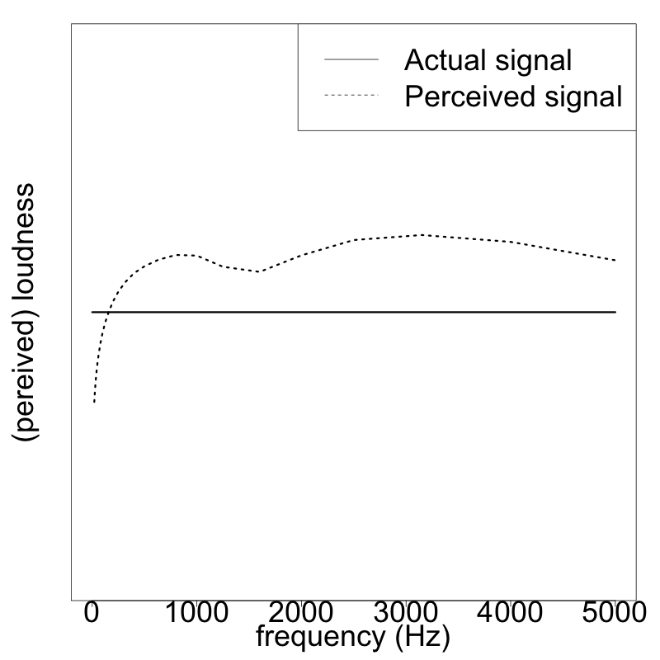

Exemplary sound features
Example: Perceived loudness
Temporal features
Energy features
Spectral features
Harmonic features
Perceptual features
Source: Peeters (2004), https://www.dsprelated.com/showcode/174.php

Slide 40




More abstract sound features of songs
Exemplary features from the Spotify API
Acousticness
Danceability
Speechiness
Measures whether a track is acoustic
Describes how suitable a track is for dancing
Includes elements like tempo, rhythm, stability, beat strength, overall regularity
Detects the presence of spoken words in a track
The more exclusively speech-like the recording (e.g. talk show, audio book, poetry), the higher the classification as speech
Source: https://developer.spotify.com/web-api/get-audio-features/

Slide 41

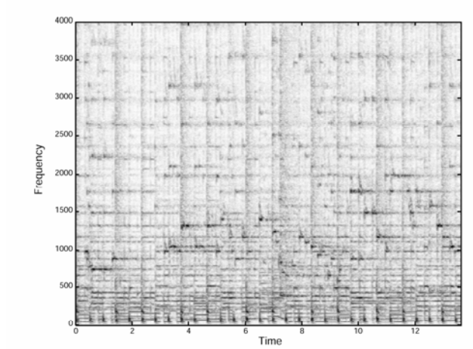
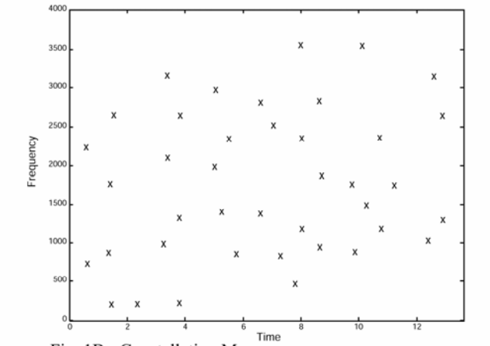
Exmplary music recognition: Shazam
Time-dependent spectrogram
Strongest frequencies
Song sample
fequency in Hz
fequency in Hz
time in s
Source: Wang (2003)

Slide 42




Some practical application fields
Speech
Nature sound
Sentiment analysis¹
Voice classification²
Automatic speaker recognition³
Speech to text systems⁴
Machine failure recognition⁶
Military sound analysis⁶
Animal sound recog-nition (e.g. birds)⁷
Music signal processing
Other
Genre identification⁵
Instrumentation⁵
Dynamics, tempo and timbre⁵
Medical hearing aid⁶
Adaptive noise cancelling⁶
Digital watermarking⁶
Source: 1) http://nlp.stanford.edu/sentiment/, 2) Pandya, Pathak (2014), 3) Kamruzzaman et al. (2010), 4) https://research.googleblog.com/2015/08/the-neural-networks-behind-google-voice.html,
5) http://signalprocessingsociety.org/uploads/special_issues_deadlines/MusicSP.pdf,
6) Perez-Meana (2007), 7) Stowell, Plumbley (2014)

Slide 44
References
Hansen, C. H., & Sehrndt, C. H. (2001). Fundamentals of acoustics. Occupational Exposure to Noise: Evaluation, Prevention and Control. World Health Organization.
http://cmc.music.columbia.edu/musicandcomputers/, last visited 21.10.2016
James, J. F. (2011). A student's guide to Fourier transforms: with applications in physics and engineering. Cambridge university press.
http://www.di.fc.ul.pt/~jpn/r/fourier/fourier.html, last visited 21.10.2016
http://www.abstractnew.com/2014/04/the-fast-fourier-transform-fft-without.html, last visited 21.10.2016
Robinson, D. W., & Dadson, R. S. (1956). A re-determination of the equal-loudness relations for pure tones. British Journal of Applied Physics, 7(5), 166.
http://www.diracdelta.co.uk/science/source/e/q/equal%20loudness%20contour/source.html#.WADCgpN940p, last visited 21.10.2016
https://developer.spotify.com/web-api/get-audio-features/, last visited 21.10.2016
Peeters, G. (2004). A large set of audio features for sound description (similarity and classification) in the CUIDADO project
https://www.dsprelated.com/showcode/174.php, last visited 21.10.2016
http://nlp.stanford.edu/sentiment/, last visited 21.10.2016
Pandya, R., & Pathak, K. (2014). Survey on Noise Estimation and Removal Methods through SVM. International Journal of Computer Applications, 86(9).
Kamruzzaman, S. M., Karim, A. N. M., Islam, M., & Haque, M. (2010). Speaker identification using mfcc-domain support vector machine. arXiv preprint arXiv:1009.4972.

Slide 45
References
https://research.googleblog.com/2015/08/the-neural-networks-behind-google-voice.html, last visited 21.10.2016
http://signalprocessingsociety.org/uploads/special_issues_deadlines/MusicSP.pdf, last visited 21.10.2016
Perez-Meana, H. (Ed.). (2007). Advances in Audio and Speech Signal Processing: Technologies and Applications: Technologies and Applications. Igi Global.
Stowell, D., & Plumbley, M. D. (2014). Automatic large-scale classification of bird sounds is strongly improved by unsupervised feature learning. PeerJ, 2, e488.
Wang, A. (2003, October). An Industrial Strength Audio Search Algorithm. InISMIR (pp. 7-13).

